Slide 1
Quantitative Analysis in Business Studies
MAN00035C
2026 - Week 9

Slide 2
Week 9: Time Series
Reading: Oakshott - chapter 13

Slide 3
Last Topic: Correlation and Regression
The correlation between two variables can be either positive or negative.
Pearson’s correlation coefficient (r) measures the strength of the linear association between two numerical variables. It lies between –1 (perfect negative association) to +1 (perfect positive association).
Correlation does not imply causation!
Regression: a way to quantify the linear relationship between a dependent and an independent variable.
Method: Least Squares
Interpretation of Regression line and SPSS output

Slide 4
Outline of the session
What is Time Series Data?
How do we model Time Series?
How can we forecast Time Series?

Slide 5
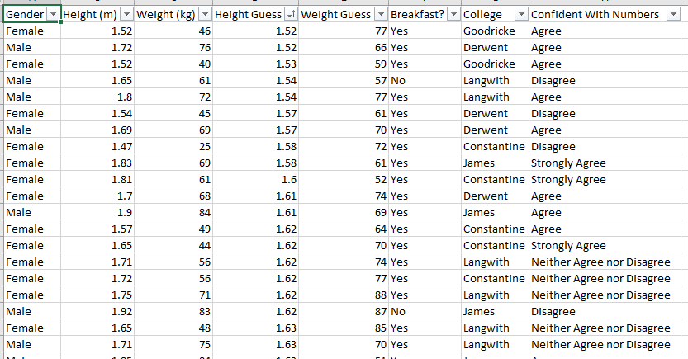
Cross-sectional Data
So far, most of the data we’ve worked with is cross-sectional data.
This means:
Data is collected from many subjects (people, firms, countries, etc.)
All at one point in time (or over a short period)
Example:
salt in pasty
Results from a survey

Slide 6
Many Things Change Over Time
Real-world variables don’t stay constant. They evolve:
Weekly ice cream sales
Number of UK residents travelling abroad
Daily production in a factory
Often, we care about:
Trends (is it increasing or decreasing?)
Patterns (seasonal changes, cycles)
In cross-sectional analysis:
Time information is not included.

Slide 7
Time Series Data: Time-Dependent Variables
If we collect data on ONE subject over MANY points or periods of time, this is called a Time Series.
In time series data, observations are often dependent on previous values:
What happens today may be influenced by yesterday
What will happen tomorrow may be influenced by today
Example: Today’s ice cream sales depend on yesterday’s sales and recent weather patterns.
With Time-Series data, the most obvious question to ask is can we ‘Forecast’ how the variable will behave in the future. (Predict future values)

Slide 8
Time Series Forecasting
future
source Google Finance

Slide 9
Time Series Forecasting
Could we do this using Simple Linear Regression with ‘Time’ as the independent variable? (something like y = a + b*time + noise)
No! Why?
There are three main issues!
1. It’s very unlikely that the time-dependent variable varies linearly with time, e.g., UK visits abroad vary up and down over seasons.
2. The observations are NOT independent. In general, the value one day most likely depends on the day before, e.g., Increasing Stock prices …
3. To `Forecast’ in the future, we would have to apply ‘extrapolation’ predictions which we have already discussed should be done with caution.

Slide 10
How to Model Time Series
Decomposition
Due to the nature of Time-Series data evolving over time, we assume that our data is subject to the most common characteristics of time:
1. Trend: the overall, long-run average movement in the data, i.e. increasing, decreasing or constant
2. Seasonality / Cyclic Behaviour:
Seasonality related to the periodic fluctuations that repeat themselves at fixed intervals of time (seasons)
Cyclic behaviour represents the generic ups and downs of the economy or industry that occur over longer intervals of time (expansion, peak, contraction, and trough)
3. Randomness: in the real world there is always variation in the data that cannot be explained.

Slide 11
How to Model Time Series
The Decomposition Model
Once we assume that our data is subject to these factors, we can then try to identify them and use them to create a statistical model for `Forecasting’. Time-Series models which incorporate these characteristics are collectively known as Decomposition Models and require us to carry out the following steps:
Identify the Trend
Identify the Seasonality (the Cyclical Behaviour is usually ignored)
Combine these in a certain way to create a model
Assess model error
Use the model to make forecasts

Slide 12
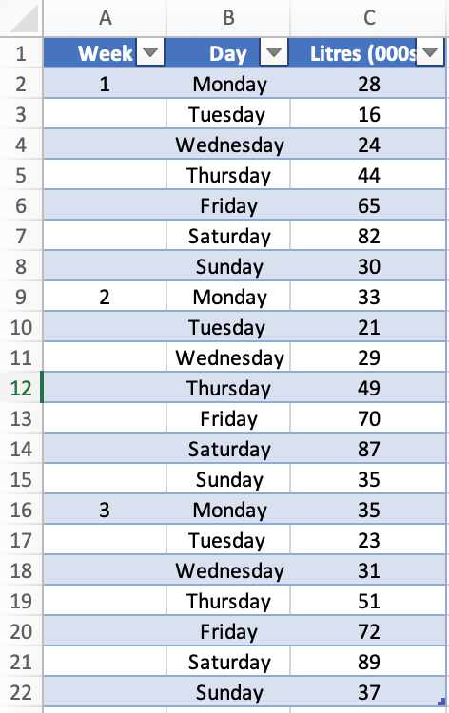
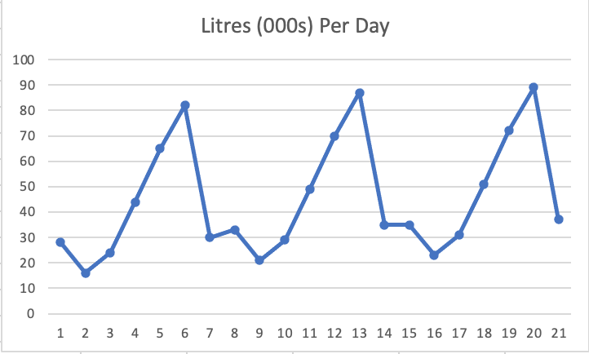
Identifying the Trend
Consider the sale of petrol at a local petrol station on each day of the week over a 3-week period:

Slide 13
Identifying the Trend
We can remove seasonal fluctuations by calculating the average petrol sales for weeks:
Week 1: (28+16+24+44+65+82+30)/7 = 41.3
Week 2: (33+21+29+49+70+87+35)/7 = 46.3
Week 3: (35+23+31+51+72+89+37)/7 = 48.3

Slide 14
Identifying the Trend
We can obtain more than 3 averages:
Monday to Sunday: (28+16+24+44+65+82+30)/7 = 41.3
Tuesday to Monday: (16+24+44+65+82+30+33)/7 = 42.0
Thursday to Tuesday: (24+44+65+82+30+33+21)/7 = 42.7
…
…
Week 2: (33+21+29+49+70+87+35)/7 = 46.3
…
…
Week 3: (35+23+31+51+72+89+37)/7 = 48.3

Slide 15
Identifying the Trend
Centred Moving Average
A 𝑘 period `centred moving average’ (CMA) is an average taken over 𝑘 periods, which is then plotted in the `centre’ of those values.
We then shift everything along by one period to take the next average and so on.
The idea of this averaging is to `smooth’ out the seasonal effects or spikes in the data making the trend much easier to identify and then use to forecast future values.

Slide 16
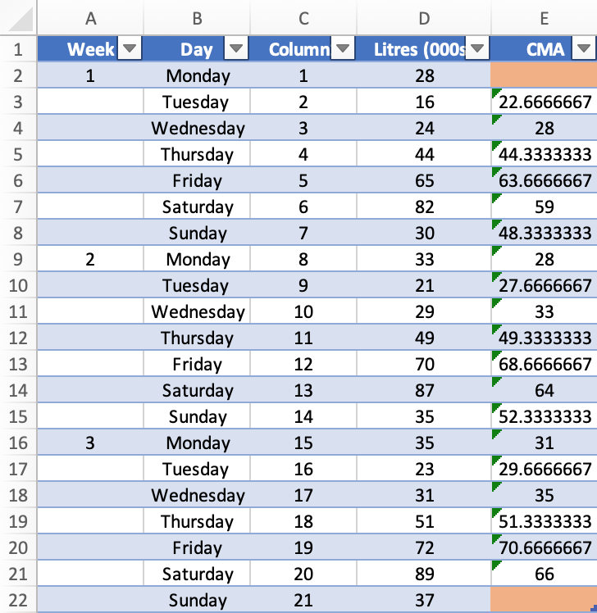
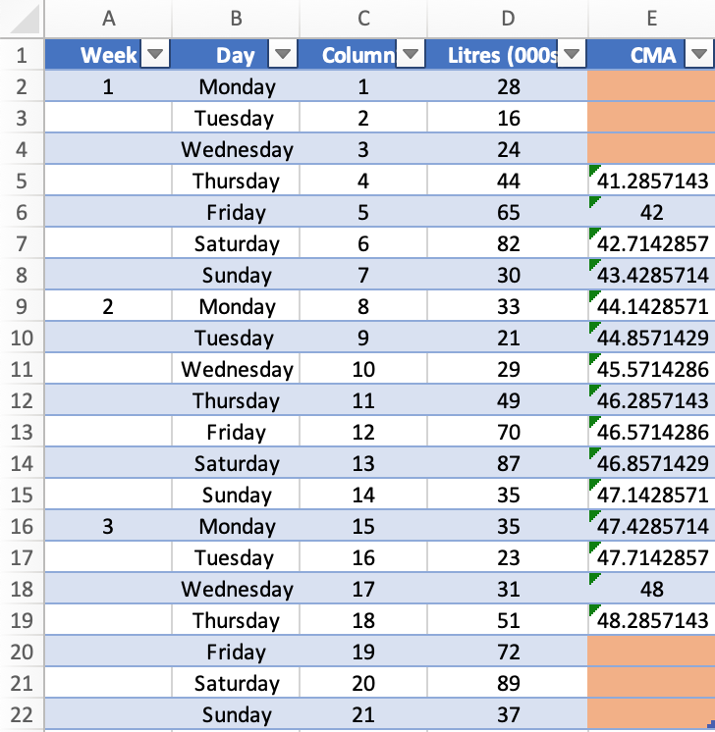
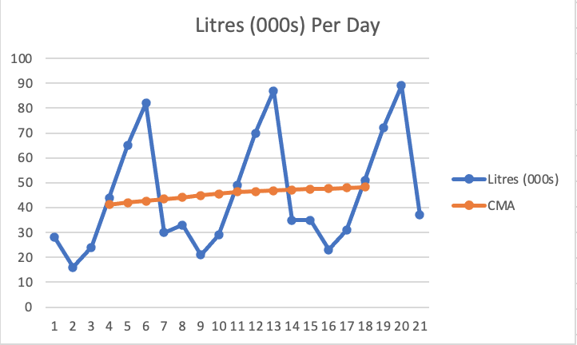
Example
𝑘=7, thus a 7-period Centred Moving Average!

Slide 17
Identifying the Trend
Centred Moving Average (Odd 𝑘)
When the number of periods is odd, i.e., 𝑘=3, 5, 7, 𝑒𝑡𝑐., the method of Centred Moving Averages is fairly straightforward.
For example, if 𝑘=3, then we simply take the average over the first 3 observations and plot this against the `centre’ value, i.e., observation number 2.
We then move along 1 period and take the average of observations 2, 3, and 4, and plot this in the centre of these values, i.e. observation number 3 and so on.
Let’s look at an example of an even-period CMA.

Slide 18
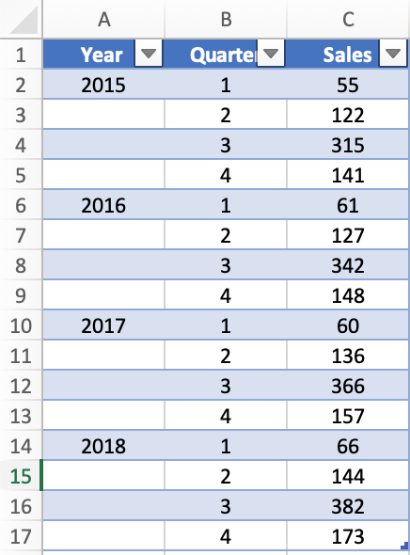
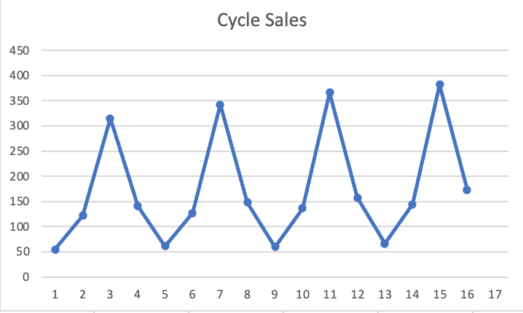
Example (even k)

Slide 19
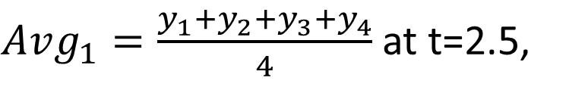
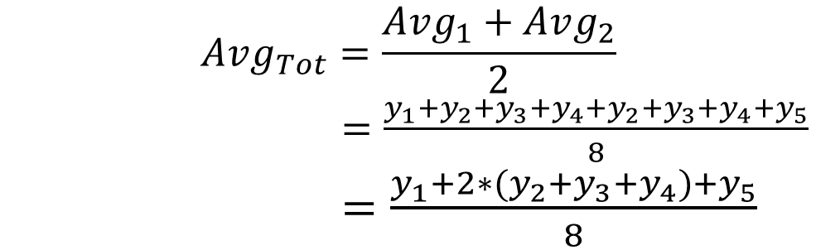
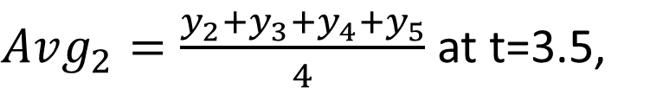
Example (odd k)
$Avg_{1}=\frac{y_{1}+y_{2}+y_{3}+y_{4}}{4}$ at t=2.5,
$Avg_{2}=\frac{y_{2}+y_{3}+y_{4}+y_{5}}{4}$ at t=3.5,
$$Avg_{Tot}=\frac{Avg_{1}+Avg_{2}}{2}$$
$=\frac{y_{1}+y_{2}+y_{3}+y_{4}+y_{2}+y_{3}+y_{4}+y_{5}}{8}$ $=\frac{y_{1}+{2∗(y}_{2}+y_{3}+y_{4})+y_{5}}{8}$
at t=3.

Slide 20
Identifying the Trend
Centred Moving Average (Even 𝑘)
When the number of periods is even, i.e., 𝑘=2, 4, 6 𝑒𝑡𝑐., the method of centred moving averages becomes a little more complicated.
Why?
For example, if you take the average of the first 4 observations, where is the `centre’?
Technically, the centre is at the value of 2.5 but this does not make much sense as this does not connect to an actual period so it becomes somewhat meaningless and difficult to plot.

Slide 21
Identifying the Trend
Centred Moving Average (Even 𝑘)
Hence, to overcome this we need to take the average of averages!
That is, we would take the average of the first 4 observations, then take the average of observations 2 - 5 and finally, take the average of these two averages.
The centre for both of the individual averages is 2.5 and 3.5, respectively, so the average of these two now has a centre at 3, which has some meaning again and we can plot our CMA at this point.

Slide 22
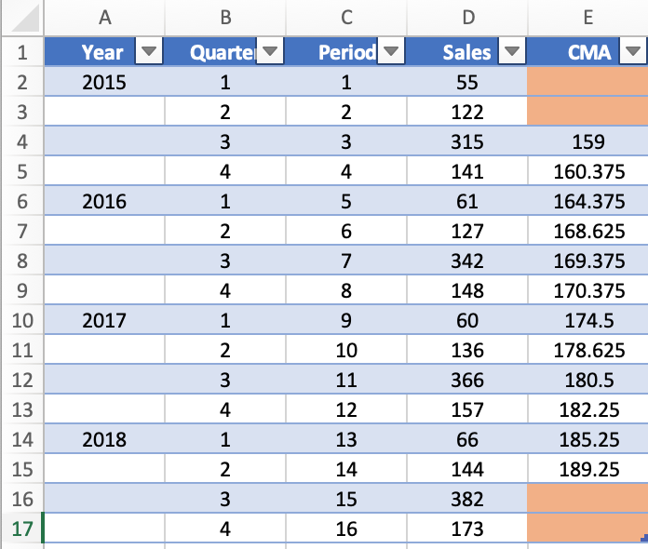

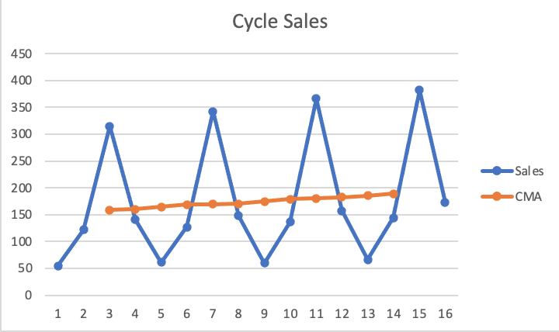
Example (even k)
𝑘=4, thus a 4-period Centred Moving Average!

Slide 23
How to Model Time Series
Decomposition
Once we assume that our data is subject to these factors, we can then try to identify them and use them to create a statistical model for `Forecasting’. Time-Series models which incorporate these characteristics are collectively known as Decomposition Models and require us to carry out the following steps:
Identify the Trend
Identify the Seasonality
Combine these in a certain way to create a model
Assess model error
Use the model to make forecasts

Slide 24
Identifying the Trend
Centred Moving Average
What value of 𝑘 should we choose?
To smooth out ALL of the seasonal effects, it is usually best to choose 𝑘 to be equal to the number of seasons!
See the following example when the number of season is 7 but k=3.

Slide 25

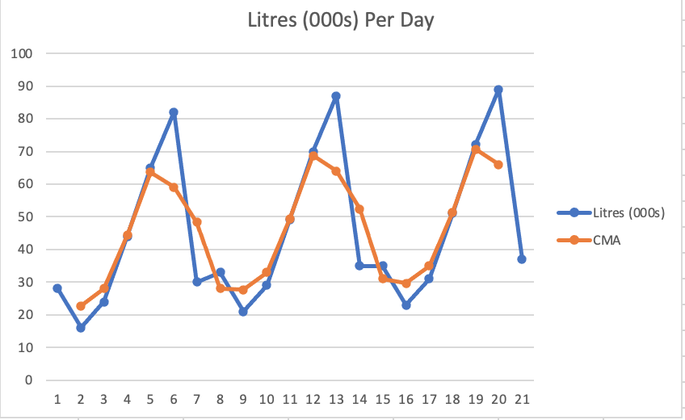
Example
𝑘=3, thus a 3-period Centred Moving Average!

Slide 26
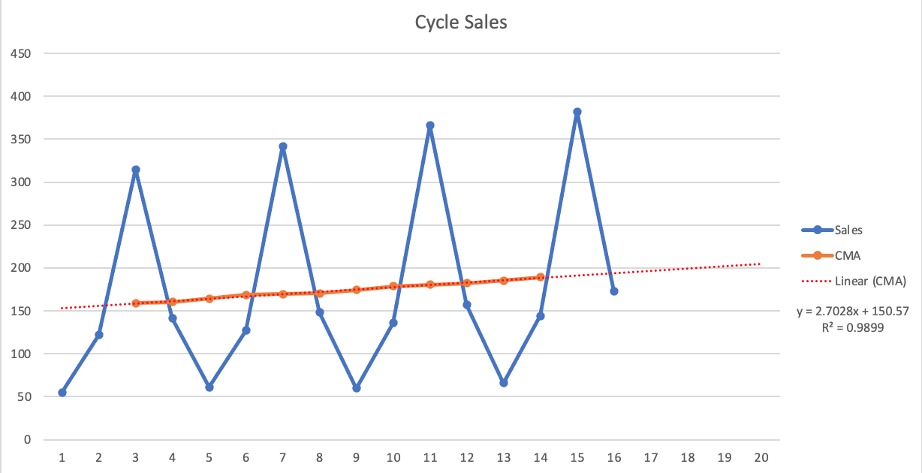
Using CMA to Forecast
Plot Simple Linear Regression Line

Slide 27
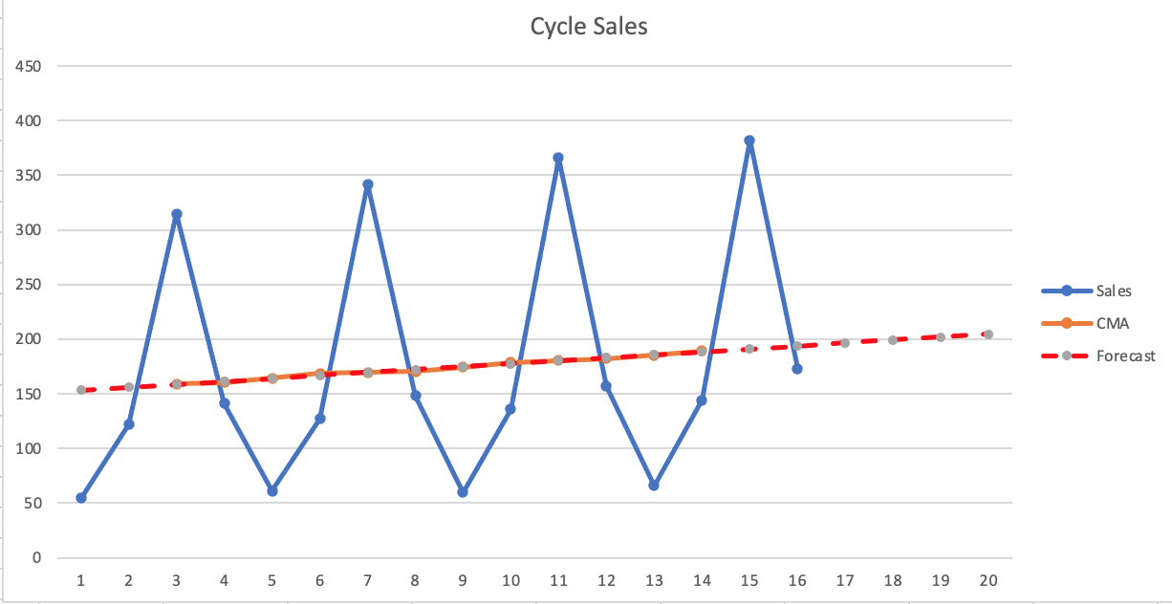
Using CMA to Forecast
Use FORECAST.LINEAR() in Excel!

Slide 28
Summary
Time-Series Data: data on ONE subject over MANY points or periods of time
How to model Time-Series?
→The decomposition: describe the trend, seasonality and cyclical behaviour within the data as well as the random component.
Identify the Trend: Using CMA ← WE ARE HERE
Identify the Seasonality
Combine these in a certain way to create a model
Assess model error
And, finally, the last step is to Forecast, namely to make predictions based on the past time-series.
5. Use the model to make forecasts

Slide 29

Survey

Slide 30
Outline of the session
How can we identify Seasonality?
Additive and Multiplicative Seasonality
Last session:
How can we identify Trend?

Slide 31
Identifying Seasonality
Seasonality is deﬁned to be the tendency of time-series data to exhibit behaviour that repeats itself every 𝑘 periods.
The simplest way to identify the value of 𝑘 is to plot your time-series data and observe after how many periods the pattern begins to repeat.
Some examples of different periods of seasonality are:
Daily seasonality, e.g., City traffic
Weekly seasonality e.g., Rental car demand
Monthly/Quarterly seasonality e.g., Online Spending
Yearly seasonality e.g, Temperatures

Slide 32
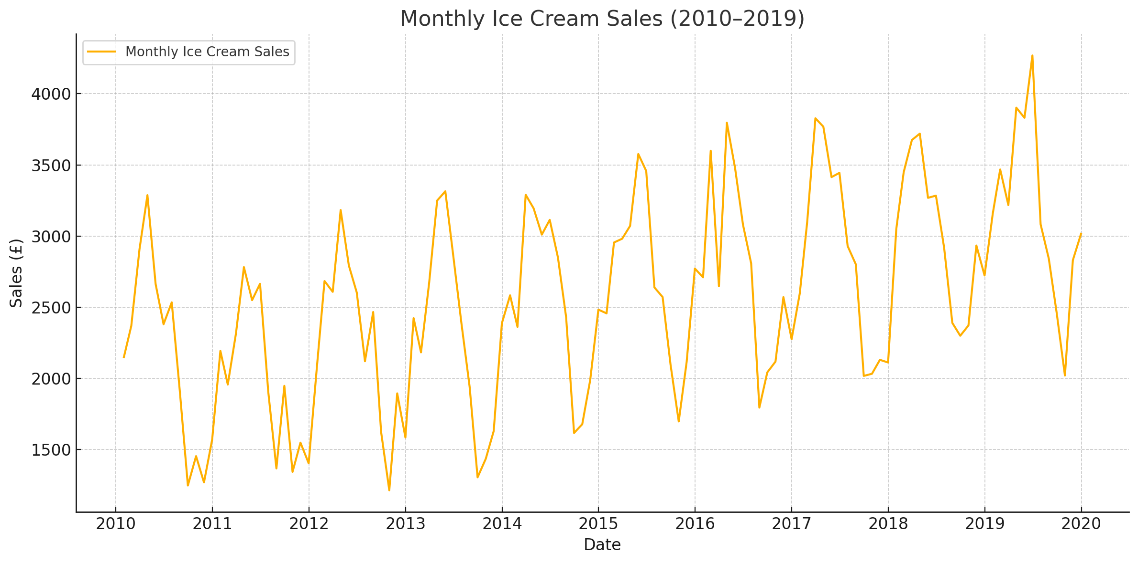
Identifying Seasonality

Slide 33
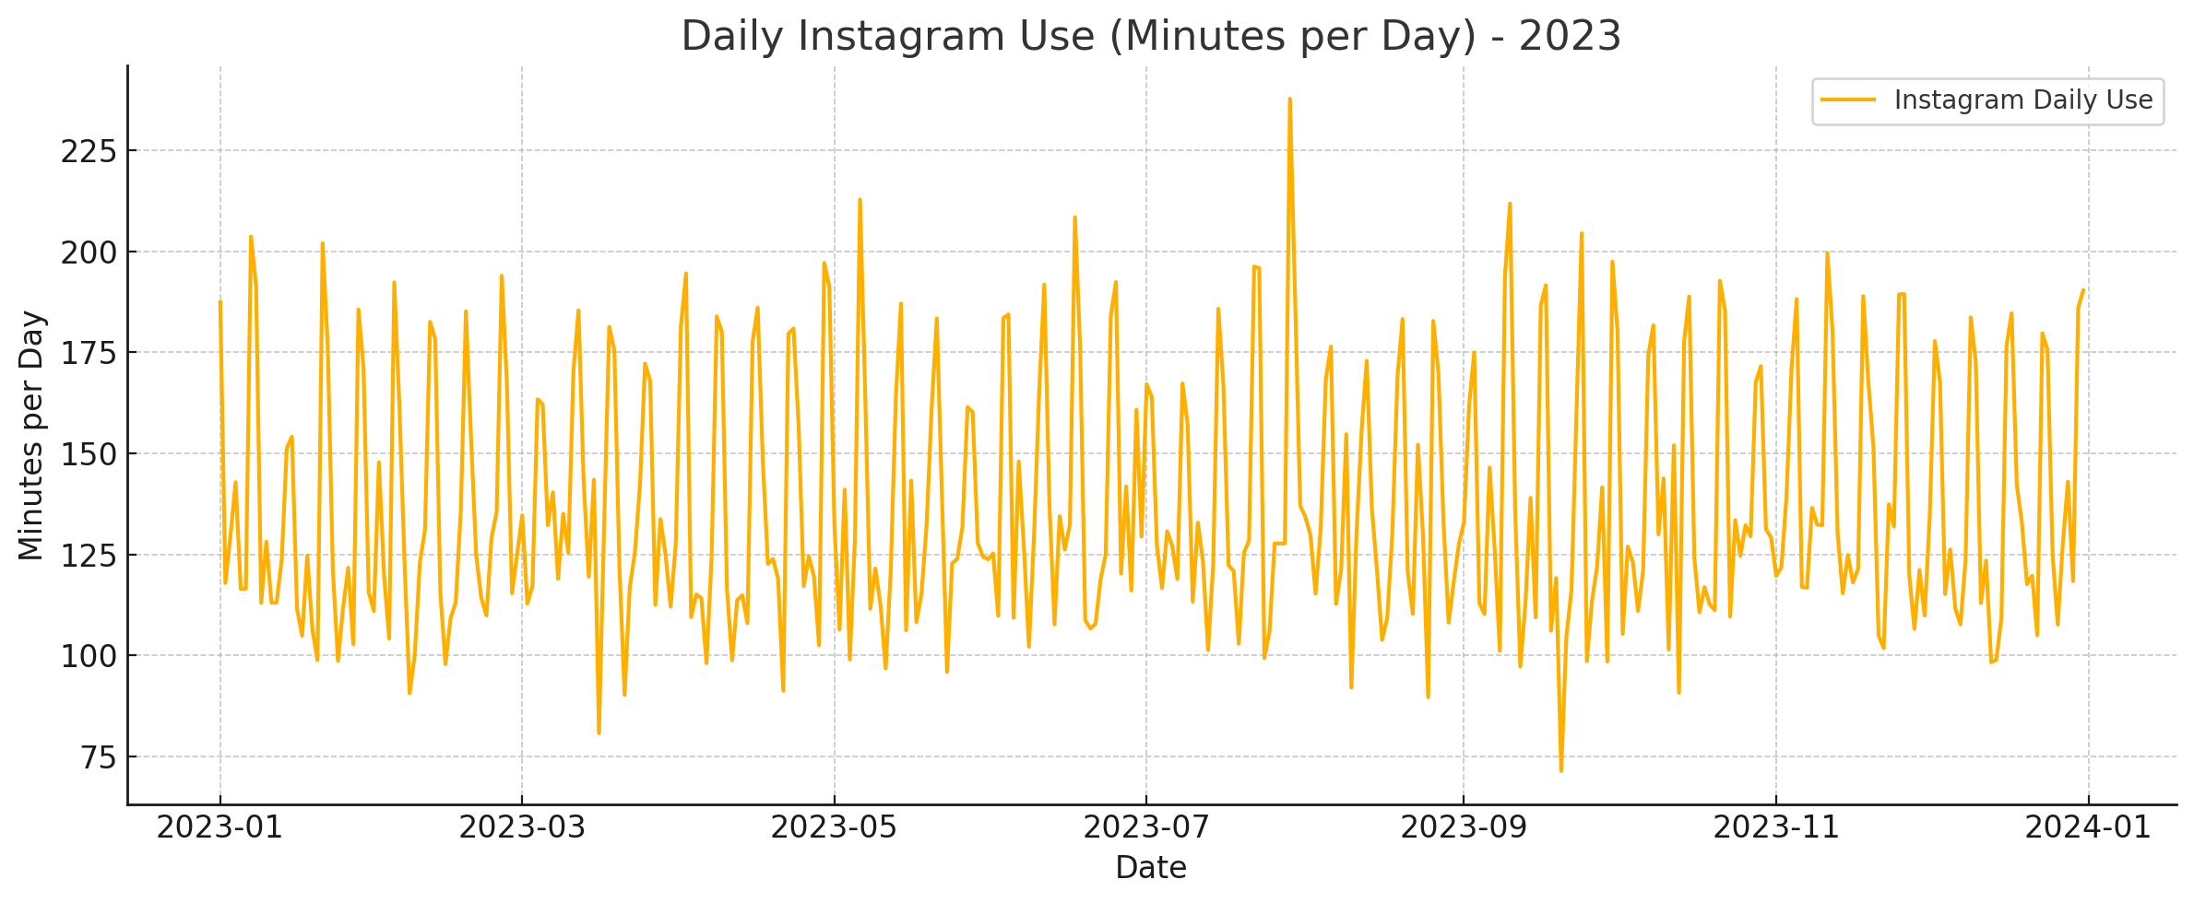
Identifying Seasonality

Slide 34
Identifying Seasonality
k = 4 period season

Slide 35
Identifying Seasonality
k = 4 period season → pattern repeats itself every 4 periods

Slide 36
Identifying Seasonality
Additive
Types of Seasonality: Additive and Multiplicative
Additive seasonality occurs when the variation in the data due to seasonality is constant over time. That is, you can draw parallel lines at the peaks and the troughs.

Slide 37
Identifying Seasonality
Additive
Types of Seasonality: Additive and Multiplicative
Additive seasonality occurs when the variation in the data due to seasonality is constant over time. That is, you can draw parallel lines at the peaks and the troughs.
Multiplicative seasonality occurs when the variation due to seasonality either increases or decreases over time. In this case, you will have non-parallel lines at the peaks and troughs.
Multiplicative

Slide 38
Additive Model
Now, let’s discuss methods for identifying and quantifying the seasonality effects for Additive seasonality using the so-called Additive Decomposition model:
$$y_{t}=Trend_{t}+Seasonality_{t}+Cyclic_{t}+Randomness_{t}$$
$$=T_{t}+S_{t}+C_{t}+ε_{t}$$

Slide 39
Additive Model
Now, let’s discuss methods for identifying and quantifying the seasonality effects for Additive seasonality using the so-called Additive Decomposition model:
$$y_{t}=Trend_{t}+Seasonality_{t}+Cyclic_{t}+Randomness_{t}$$
$$=T_{t}+S_{t}+C_{t}+ε_{t}$$
where 𝑦𝑡 denotes the value of our dependent variable at period (time) t. However, since we will only look at data over `short` time periods (a few years at most), we will assume that cyclic fluctuations do not exist. In this case, the additive model reduces to:
$$y_{t}≈ Trend_{t}+Seasonality_{t}+Randomness_{t}$$
$$≈T_{t}+S_{t}+ε_{t}$$

Slide 40
Recall
How to model Time-Series?
→The decomposition: describe the trend and seasonality within the data as well as the random component.
Identify the Trend: a smoothing method known as moving averages (SMA and CMA)
Identify the Seasonality
Combine these in a certain way to create a model ← WE ARE HERE
Assess model error (→ how important is the random component; if large, not accurate predictions)
Finally, the last step is to Forecast, namely to make predictions based on the past time-series.
5. Use the model to make forecasts

Slide 41
Additive Model
Now, let’s discuss methods for identifying and quantifying the seasonality effects for Additive seasonality using the so-called Additive Decomposition model:
$$y_{t}=Trend_{t}+Seasonality_{t}+Cyclic_{t}+Randomness_{t}$$
$$=T_{t}+S_{t}+C_{t}+ε_{t}$$
where 𝑦𝑡 denotes the value of our dependent variable at period (time) t. However, since we will only look at data over `short` time periods (a few years at most), we will assume that cyclic fluctuations do not exist. In this case, the additive model reduces to:
$$y_{t}≈ Trend_{t}+Seasonality_{t}+Randomness_{t}$$
$$≈T_{t}+S_{t}+ε_{t}$$

Slide 42
Additive Model
Now that we have the form of the model, we need to obtain estimates for the Trend values (𝑇𝑡) and the Seasonality values (𝑆𝑡).
Note that the random component (𝜖𝑡) is `random’ and as such, we cannot estimate its value (similar to linear regression) and we can only estimate the other two terms!

Slide 43
Additive Model
Now that we have the form of the model, we need to obtain estimates for the Trend values (𝑇𝑡) and the Seasonality values (𝑆𝑡).
Note that the random component (𝜖𝑡) is `random’ and as such, we cannot estimate its value (similar to linear regression) and we can only estimate the other two terms!
Another important thing to notice here is that the two unknown values for Trend and Seasonality are time-dependent and not fixed constants (→ both change over time!)
As such, we do not obtain just one specific value.
In fact, we have already discussed how to find the Trend values (𝑇𝑡) using CMAs (or SMAs)!

Slide 44
Example

Slide 45
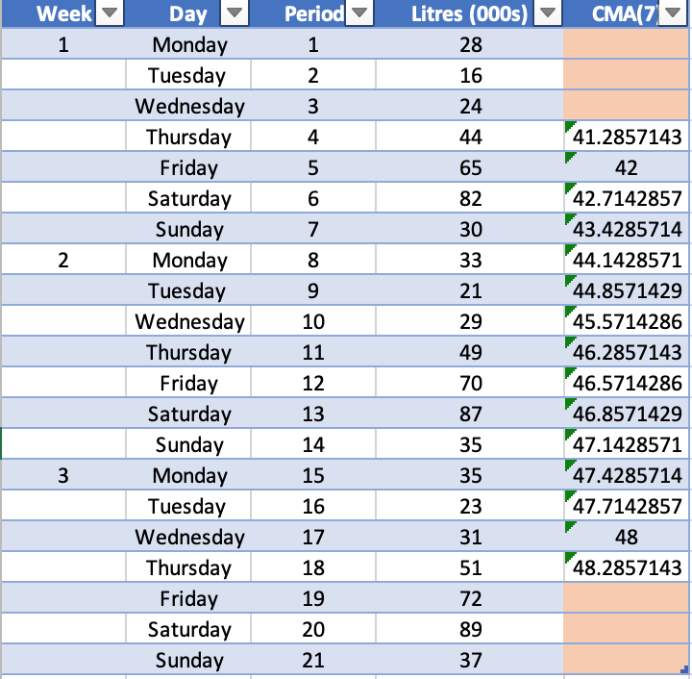
Example
𝑘=7 period Centred Moving Average!

Slide 46
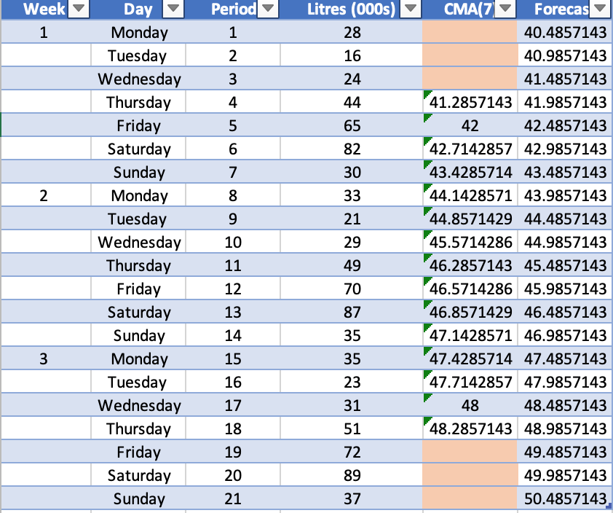
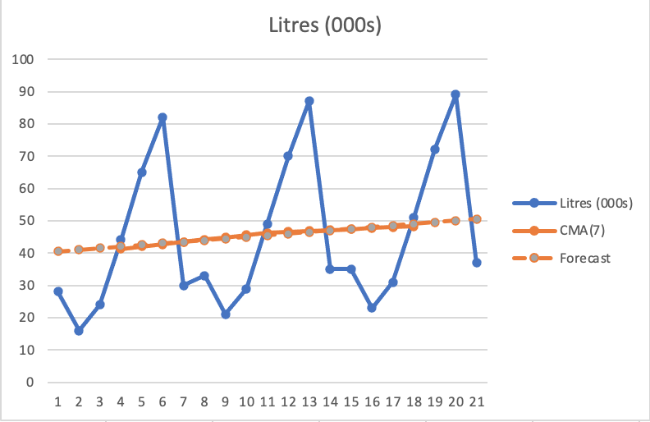
Example
$T_{t}$ - Trend Values for each period t -

Slide 47
Seasonality Values ($S_{t}$)
Now that we have the estimated Trend values (𝑇𝑡), we cay use the Additive model equation to obtain the Seasonality values (𝑆𝑡). How?
First, we calculate the so-called `de-trended’ time-series. That is:
$$D_{t}=y_{t}−T_{t}$$

Slide 48
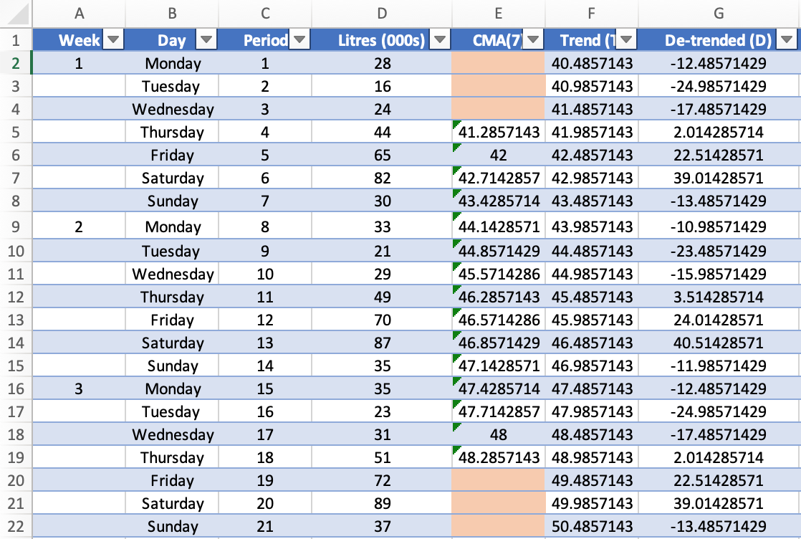
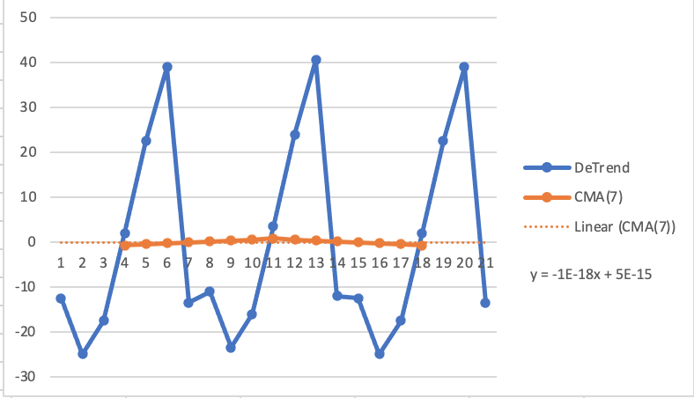
Example
$D_{t}:$ De-trended Time-Series = Actual Value - Trend

Slide 49
Seasonality Values ($S_{t}$)
Now that we have the estimated Trend values (𝑇𝑡), we cay use the Additive model equation to obtain the Seasonality values (𝑆𝑡). How?
First, we calculate the so-called `de-trended’ time-series. That is:
Second, we obtain the average seasonality effect for each period during a season from the de-trended time series:
$$D_{t}=y_{t}−T_{t}$$
$$AvgD_{i}=\frac{\sum_{i}{D_{i}}}{n_{i}}$$

Slide 50
Example
$D_{t}:$ De-trended Time-Series = Actual Value - Trend

Slide 51
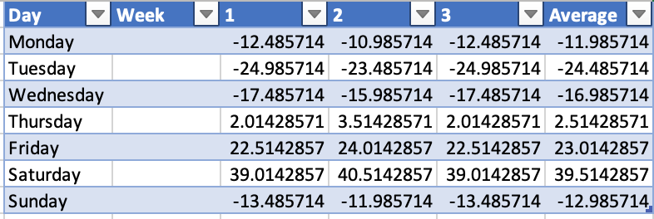
Example
Create a new table with the de-trended time series in a way that it easier to find the average across the different days!!

Slide 52
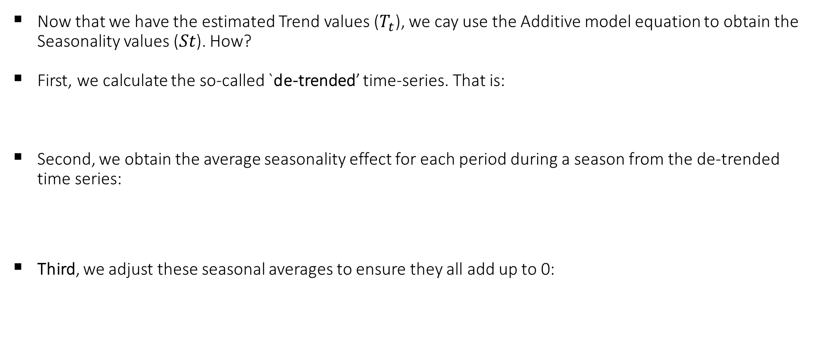
Seasonality Values ($S_{t}$)
Now that we have the estimated Trend values ($T_{t}$), we cay use the Additive model equation to obtain the Seasonality values (𝑆𝑡). How?
First, we calculate the so-called `de-trended’ time-series. That is:
Second, we obtain the average seasonality effect for each period during a season from the de-trended time series:
Third, we adjust these seasonal averages to ensure they all add up to 0:
$$D_{t}=y_{t}−T_{t}$$
$$AvgD_{i}=\frac{\sum_{i}{D_{i}}}{n_{i}}$$
$$S_{i}=AvgD_{i}−\frac{\sum_{i}{AvgD_{i}}}{k}$$

Slide 53
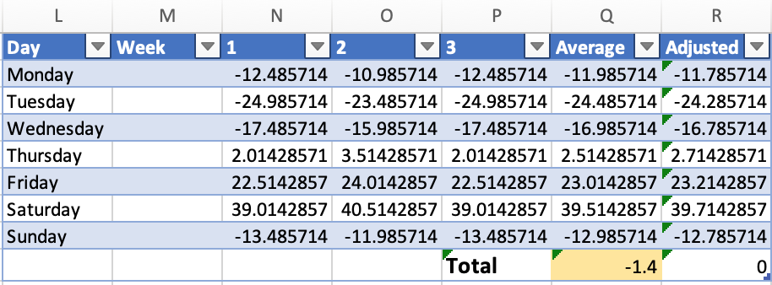

Example
Create a new table with the de-trended time series in a way that it easier to find the average across the different days!!

Slide 54
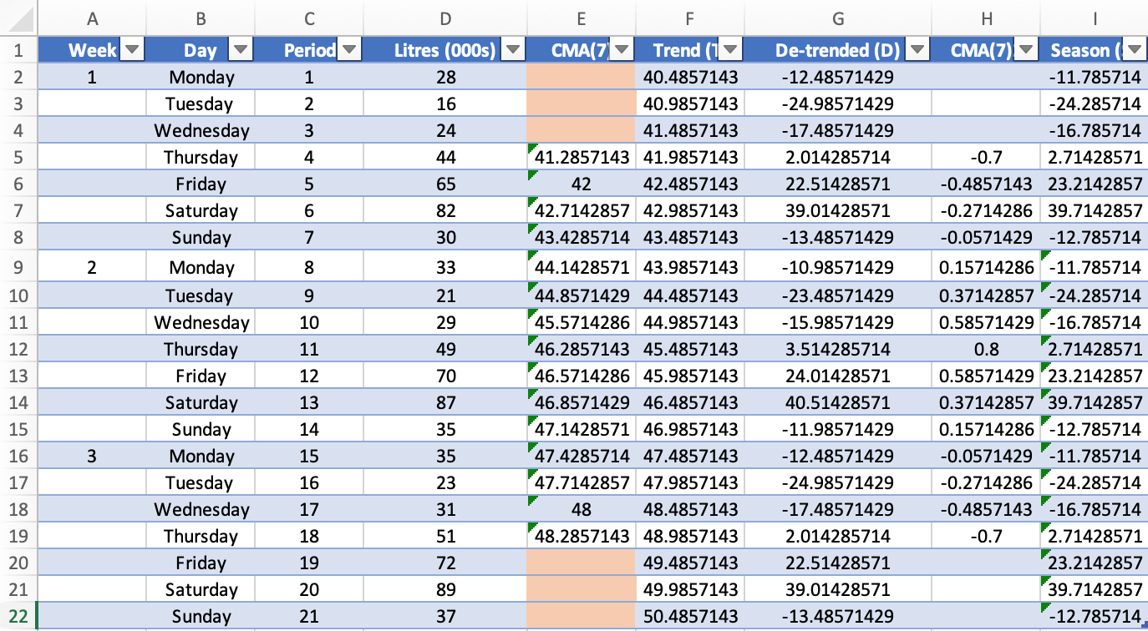
example
Example
$$S_{t}$$
$$T_{t}$$

Slide 55


Seasonality Values ($S_{t}$)
First, we calculate the so-called `de-trended’ time-series. That is:
Second, we obtain the average seasonality effect for each period during a season from the de-trended time series:
Third, we adjust these seasonal averages to ensure they all add up to 0:
Last, we plot the fitted model (predicted value):
$$D_{t}=y_{t}−T_{t}$$
$$AvgD_{i}=\frac{\sum_{i}{D_{i}}}{n_{i}}$$
$$S_{i}=AvgD_{i}−\frac{\sum_{i}{AvgD_{i}}}{k}$$
$${\hat{y}}_{t}=T_{t}+S_{t}$$

Slide 56
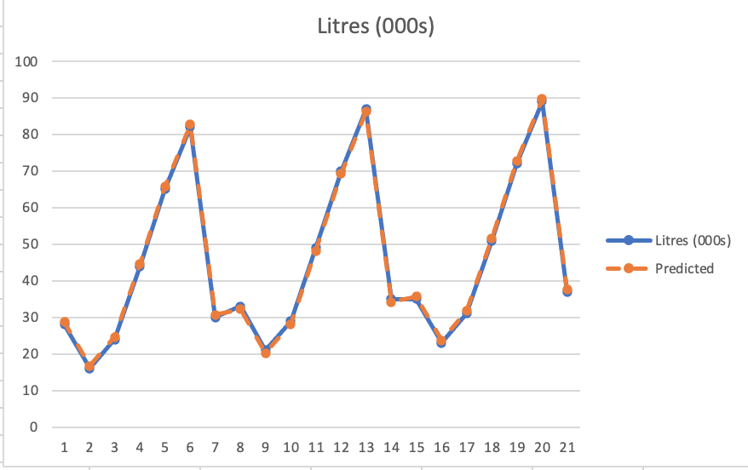
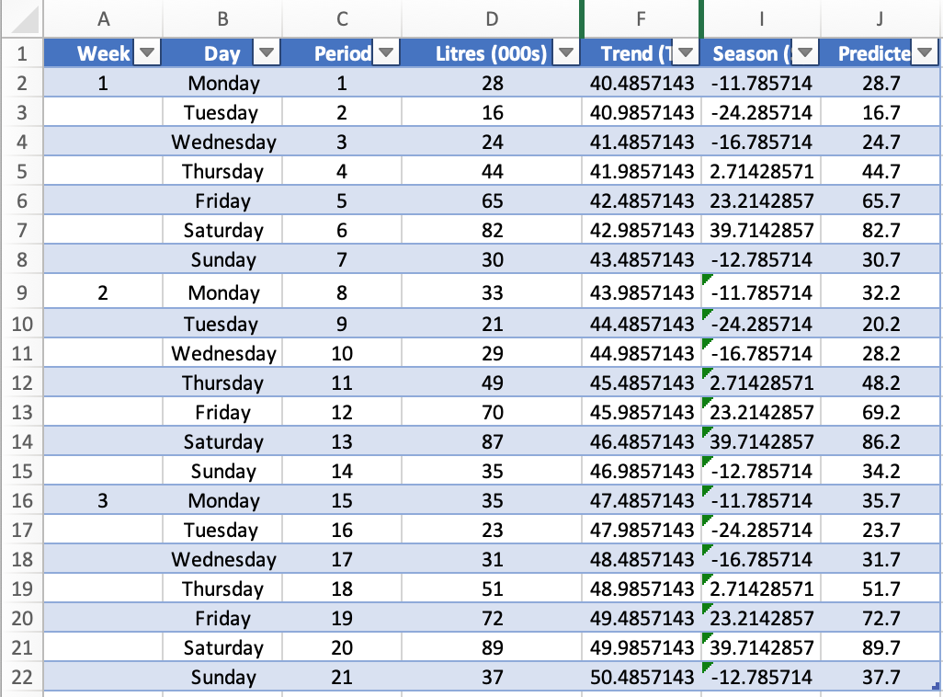

example
Example
$${\hat{y}}_{t}=T_{t}+S_{t}$$
Predicted = Trend + Season

Slide 57
Summary
Time-Series Data: data on ONE subject over MANY points or periods of time
How to model Time-Series?
→The decomposition: describe the trend and seasonality within the data as well as the random component.
Identify the Trend: Using CMA
Identify the Seasonality
Combine these in a certain way to create a model
Additive Seasonality ← WE ARE HERE
Multiplicative Seasonality
Assess model error
Use the model to make forecasts

Slide 58
Example and recap
Sales of heating oil
Year | Quarter | Sales
2013 | 1 | 280
 | 2 | 230
 | 3 | 200
 | 4 | 270
2014 | 1 | 302
 | 2 | 247
 | 3 | 220
 | 4 | 292
2015 | 1 | 320
 | 2 | 270
 | 3 | 236
 | 4 | 311
© Les Oakshott, Essential Quantitative Methods, 7th edition, 2020

Slide 59
Isolating the trend by using moving averages
The data shown on the last slide had an even number of periods (quarters)
This means that the mean of the first 4 quarters should really have been put in the middle of the year
This doesn’t really mean anything as our data is for whole quarters
© Les Oakshott, Essential Quantitative Methods, 7th edition, 2020

Slide 60
Centred moving average
© Les Oakshott, Essential Quantitative Methods, 7th edition, 2020

Slide 61
Isolating the seasonal component
Year | Quarter | Sales | 4 Quarter Moving | Centred Moving | difference
 |  |  | average | Average (Trend) | to Trend
2013 | 1 | 280
 | 2 | 230
 | 3 | 200 | 245.00 | 247.75 | -47.8
 | 4 | 270 | 250.50 | 252.63 | 17.4
2014 | 1 | 302 | 254.75 | 257.25 | 44.8
 | 2 | 247 | 259.75 | 262.50 | -15.5
 | 3 | 220 | 265.25 | 267.50 | -47.5
 | 4 | 292 | 269.75 | 272.63 | 19.4
2015 | 1 | 320 | 275.50 | 277.50 | 42.5
 | 2 | 270 | 279.50 | 281.88 | -11.9
 | 3 | 236 | 284.25
 | 4 | 311
The seasonal difference varies from quarter to quarter but also from year to year
We need to average out the different values so that we have a single value for each quarter
These averages differences should sum to zero
© Les Oakshott, Essential Quantitative Methods, 7th edition, 2020

Slide 62
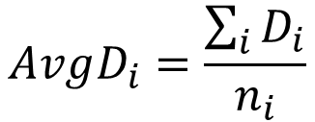

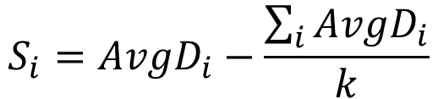
The additive model
Finally, the predicted value is given by
Quarter | 1 | 2 | 3 | 4
2013 |  |  | -47.8 | 17.4
2014 | 44.8 | -15.5 | -47.5 | 19.4
2015 | 42.5 | -11.9 |  |  | Sum
Average | 43.6 | -13.7 | -47.6 | 18.4 | 0.7
Adjusted | 43.5 | -13.9 | -47.8 | 18.2 | 0.0
$${\hat{y}}_{t}=T_{t}+S_{t}$$
$$AvgD_{i}=\frac{\sum_{i}{D_{i}}}{n_{i}}$$
$$S_{i}=AvgD_{i}−\frac{\sum_{i}{AvgD_{i}}}{k}$$
© Les Oakshott, Essential Quantitative Methods, 7th edition, 2020

Slide 63
Multiplicative Model
Additive
We discussed Additive seasonality. Now let’s move to the second type of seasonality, which is the multiplicative.
Multiplicative seasonality occurs when the variation due to seasonality either increases or decreases over time. In this case, you will have non-parallel lines at the peaks and troughs.
Multiplicative

Slide 64

Multiplicative Model
Now, let’s discuss methods for identifying and quantifying the seasonality effects for Multiplicative seasonality using the so-called Multiplicative Decomposition model:
$$y_{t}= Trend_{t}∗Seasonality_{t}∗Randomness_{t}$$
$$=T_{t}∗S_{t}∗ε_{t}$$
where 𝑦𝑡 denotes the value of our dependent variable at period (time) t.

Slide 65
Multiplicative Model
The seasonal factors are found by dividing the series by the trend to give the ratio to the trend
When the series is above the trend the factor will be above 1 (or 100%)
When below the factor will be less than 1 (or 100%)
The sum of the factors will be the number of periods of the data – for quarters it should be 4 (or 400%)
Year | Quarter | Sales | 4 quarter moving average | Centred moving average | Ratio to trend
2013 | 1 | 280
 | 2 | 230
 | 3 | 200 | 245.0 | 247.8 | 0.807
 | 4 | 270 | 250.5 | 252.6 | 1.069
2014 | 1 | 302 | 254.8 | 257.3 | 1.174
 | 2 | 247 | 259.8 | 262.5 | 0.941
 | 3 | 220 | 265.3 | 267.5 | 0.822
 | 4 | 292 | 269.8 | 272.6 | 1.071
2015 | 1 | 320 | 275.5 | 277.5 | 1.153
 | 2 | 270 | 279.5 | 281.9 | 0.958
 | 3 | 236 | 284.3
 | 4 | 311
© Les Oakshott, Essential Quantitative Methods, 7th edition, 2020

Slide 66

Average seasonal factors
Quarter | 1 | 2 | 3 | 4 | Sum
2013 |  |  | 0.807 | 1.069
2014 | 1.174 | 0.941 | 0.822 | 1.071
2015 | 1.153 | 0.958
Average | 1.164 | 0.949 | 0.815 | 1.070 | 3.998
Adjusted | 1.164 | 0.950 | 0.815 | 1.071 | 4
Finally, The predicted value is given by
$${\hat{y}}_{t}=T_{t}×S_{t}$$
Each value is multiplied by 4/3.998
© Les Oakshott, Essential Quantitative Methods, 7th edition, 2020

Slide 67
How do we decide which model to use?
By looking at the time series chart. (Are the seasonal swings constant or do they increase or decrease with the trend?)
By calculating the mean square error (MSE)
This statistic measures the error in the prediction. We want the model that gives us the smallest MSE
© Les Oakshott, Essential Quantitative Methods, 7th edition, 2020

Slide 68
What Are Forecast Errors?
When we forecast, we predict a value. But usually, the prediction is not exactly the real value. Forecast error is the difference between what really happened and what we predicted.
Error = Actual value − Predicted value
We want to know:
How big the mistakes are.
How often we make big mistakes.
To measure this, we can calculate:
MAE (Mean Absolute Error)→ Average size of the mistakes.
MSE (Mean Squared Error)→ Average of mistakes squared (punishes big mistakes more).
RMSE (Root Mean Squared Error)→ Like MSE, but goes back to the same units as the data.
MAPE (Mean Absolute Percentage Error)→ Mistakes as a percentage of the real value.

Slide 69
How to Calculate the Errors
Step-by-step:
Calculate the Error for Each Period: Error = Actual−Predicted
Take the absolute value of each error (ignore minus signs).
Square each error (multiply it by itself).
Find averages:
Average of squared errors = MSE
Average of absolute errors = MAE
Take the square root of MSE to find RMSE.
Find MAPE by dividing the absolute error by the real value and turning it into a %

Slide 70
example
Back to the Example
The MSE for the additive model was 1.42 and for the multiplicative model it was 4.3
The additive model is therefore a better model for this time series.
When we forecast using the multiplicative model we must remember to multiply the forecast trend by the seasonal factors
© Les Oakshott, Essential Quantitative Methods, 7th edition, 2020

Slide 71
Forecast Future Values
To forecast, we extrapolate the trend (CMA)
Then combine it with Seasonality value/factor
Additive model: CMA+S
Multiplicative model: CMA*S

Slide 72
Conclusion
Time-Series Data: data on ONE subject over MANY points or periods of time
How to model Time-Series?
Decomposition Models
Identify the Trend: use CMA
Identify the Seasonality
Combine these in a certain way to create a model
Additive model
Multiplicative model
Assess model error: use MSE
Use the model to make forecasts
Additive model: CMA+S
Multiplicative model: CMA*S
Next Week:
Introduction to Big Data

